Slide 1

Microsoft Global Secure Access
Marius Sandbu
Cloud Evangelist – Sopra Steria Norway
Blog: https://msandbu.org

Slide 2
IT security overview
Over 28,000 critical vulnerabilities reported in 2023 (up 15% from 2022)
The majority of attacks via phishing or misconfigured services
Ransomware attack attempts happen every 11 seconds*
Just over 20,000 critical vulnerabilities reported in 2021
More attacks targeting development environments and modern applications
Critical vulnerabilities included VDI and NUMEROUS VPN vendors
On average, an organization takes between 30 – 60 days to get updates installed
New continuous records at DDoS attacks (last at 46 million RPS)

Slide 3
When ransomware stops production
End User and Machine were compromised via email
Exploited vulnerabilities to gain access to infrastructure
Data exported to somewhere
17:40
01:30
01
02
03
04
05
06
16:30
23:30
00:50
Attacker maps the network and gains access
Gains access to the backup service as well as the virtualization environment
Ran encryption script

Slide 4
Zero-Trust based access
Health check identity
Never trust, always verify
Health check device
ZTNA
SaaS
TCP/UDP
Web Apps
Windows Apps
File Storage
Jumphost
End-user
Conditions
Location
Time
Data
Session

Slide 5
Microsoft´s approach to ZTNA (up until now)
Entra ID
SaaS
Entra Directory
Azure Bastion
Jumphost
Azure Application Proxy
Internal Web
Azure Virtual Desktop / W365
VDI
Conditional Access
Azure VPN with Azure AD
TCP/UDP
Intune & Defender
Azure Arc
SSH/K8s
Microsoft Tunnel
TCP/UDP

Slide 6
So what is Global Secure Access?
Global Secure Access is Microsoft's Security Service Edge solution
Not SASE (Since its missing the SD-WAN component)...
Was announced and made available in Juli 2023 in preview
Microsoft Entra Private Access (Public Preview)
Microsoft Entra Internet Access(Private Preview)
Think about this as providing security to the network layer
Licence requirements are P1 for Private Access and E3 for Internett Access (might change)
Support for Windows 10/11 (Mac, iOS and Android to in preview) Built upon Entra ID, Conditional Access og Application Proxy
Connect either using client or network connection from the office (S2S VPN)

Slide 7
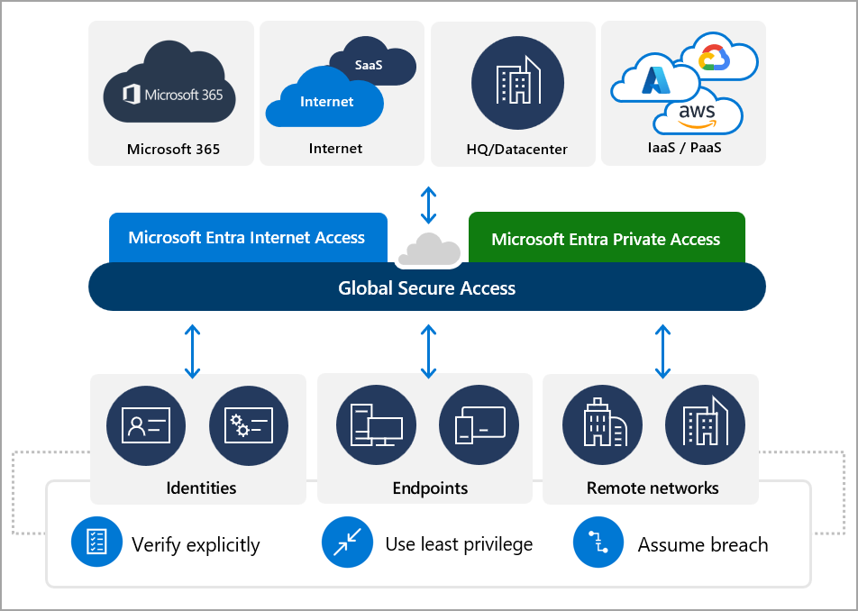

Slide 8

Global Secure Access - Overview
Entra Private Access
Per App VPN
Client installed on Machine
Microsoft Network
Azure Application Proxy (modified)
Internal Services
Conditional Access
Entra Internet Access
Forwarding Policies
Secure Web Gateway
SaaS
Site-to-site VPN
Location
Web filtering policies
Just remember the closest PoPs Global Secure Access points of presence - Global Secure Access | Microsoft Learn

Slide 9
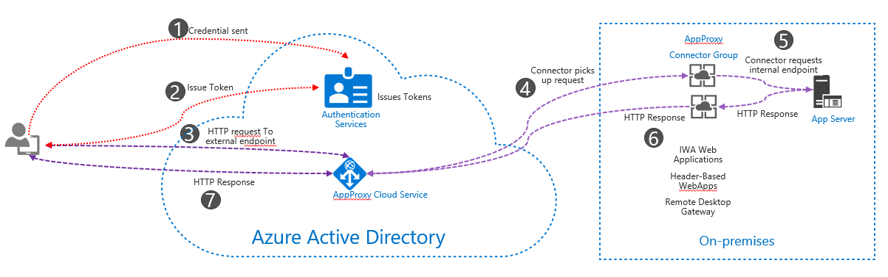
The core component of Private Access
Not yet full feature set as the existing App Proxy component
Same principle of traffic flow and protocol
Microsoft working on making existing features available in the same service

Slide 10
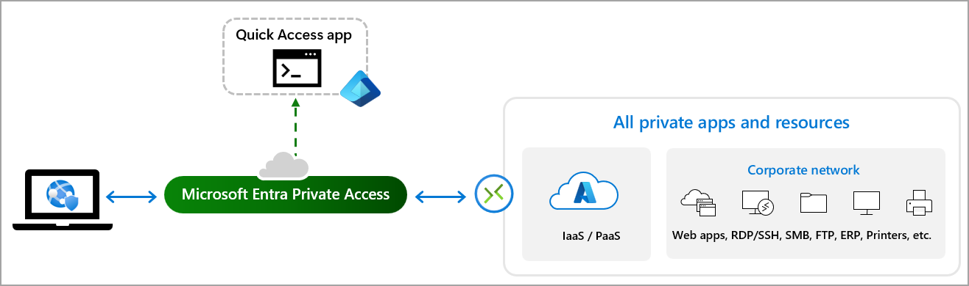
Microsoft Entra Private Access
Traffic tunneled over R-TCP
Just remember that it WILL add some latency
Requires Windows Server.... (but can run anywhere)

Slide 11
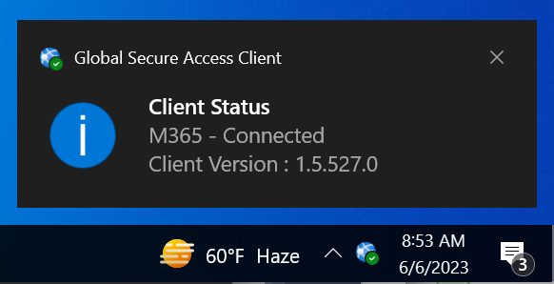
GSA Client
Uses a lightweight filter driver on the OS (Windows)
Can co-existing with a VPN services (but you really shouldnt..)
Forwarding profiles that decides if traffic should be routed trough it
Requires Entra ID Joined
If Client is not able to connect the service will bypass the traffic
Unless Conditional policies are properly configured
For Android requires defender for endpoint
Events and logs are stored in
Applications and Services/Microsoft/Windows/Global Secure Access Client/Operational

Slide 12
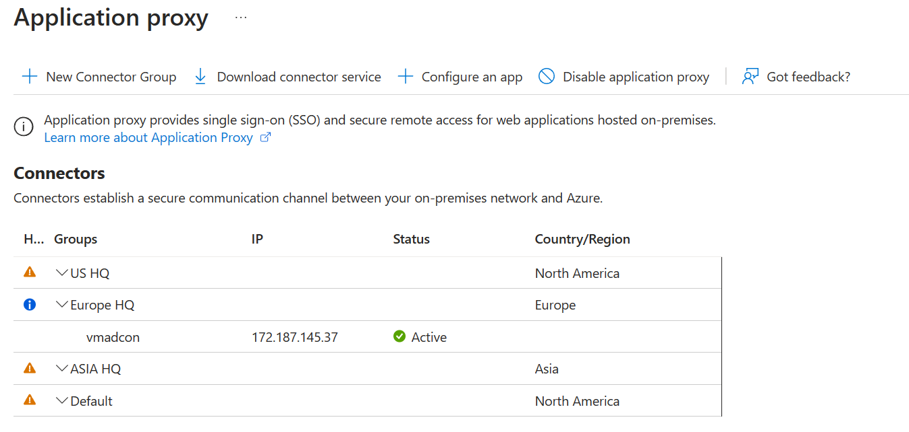
Configure Application Proxy
Make sure to change accordingly to each region (proximity)
Multiple Connectors in a Group will load balance sessions

Slide 13
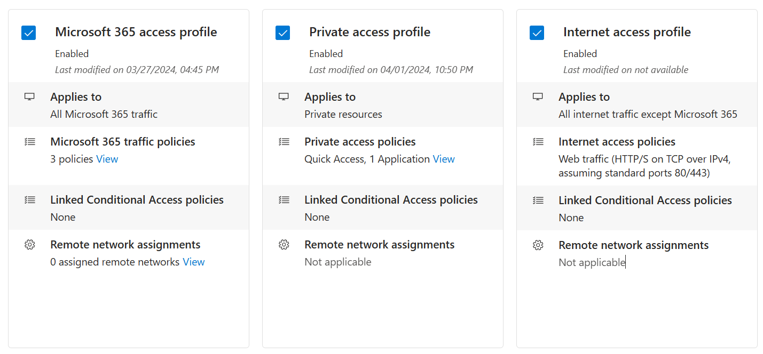
Forward policies
Policies that define what kind of traffic should be routed
Services/Networks not defined will not be routed via the service
Can be viewed as a split-tunnelig mechanism
NOTE: Currently only the agent can use private access

Slide 14
Quick Access and Enterprise Applications
Quick Access
Used to define access to a large set of resources
Such as IP, IP Range or FQDN + Ports that you want to alllow
Only one conditional access policy can be assigned to that scope
Per App Access
Used to defined access to a single service
Can have multiple conditional access policies to a subset of users

Slide 15
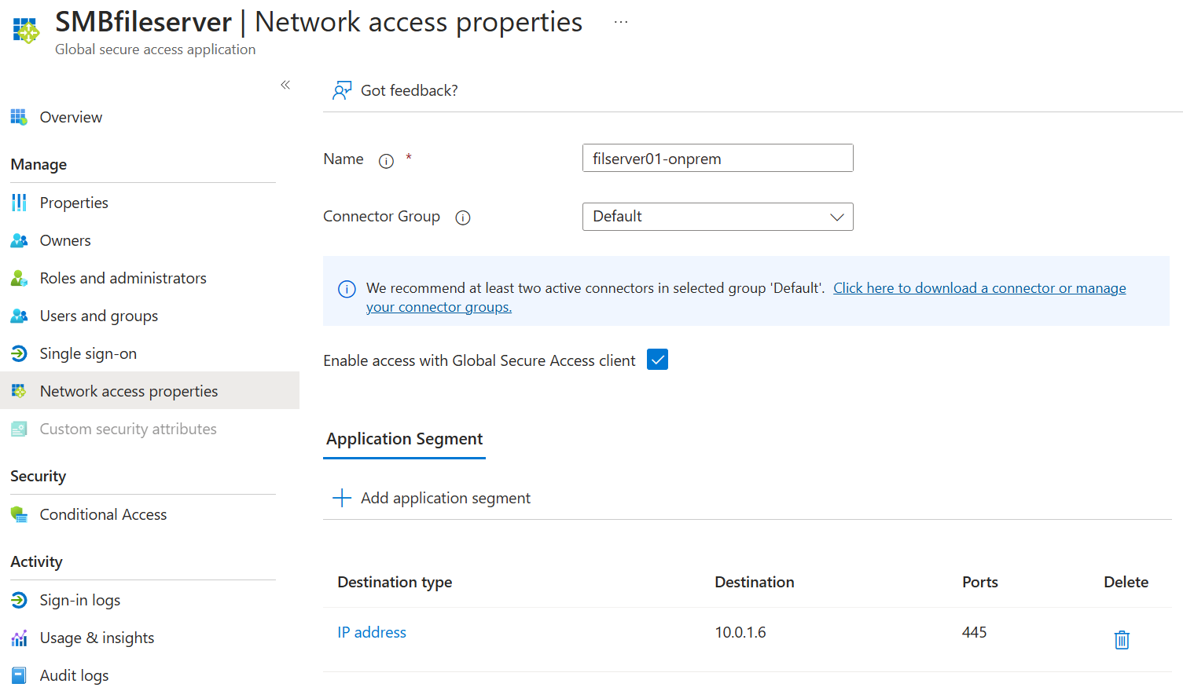
Example with Per App Access
Add access via users and groups
Remeber this checkbox to route traffic
Can be IP, IP Range or FQDN
Optionally add CA rules

Slide 16
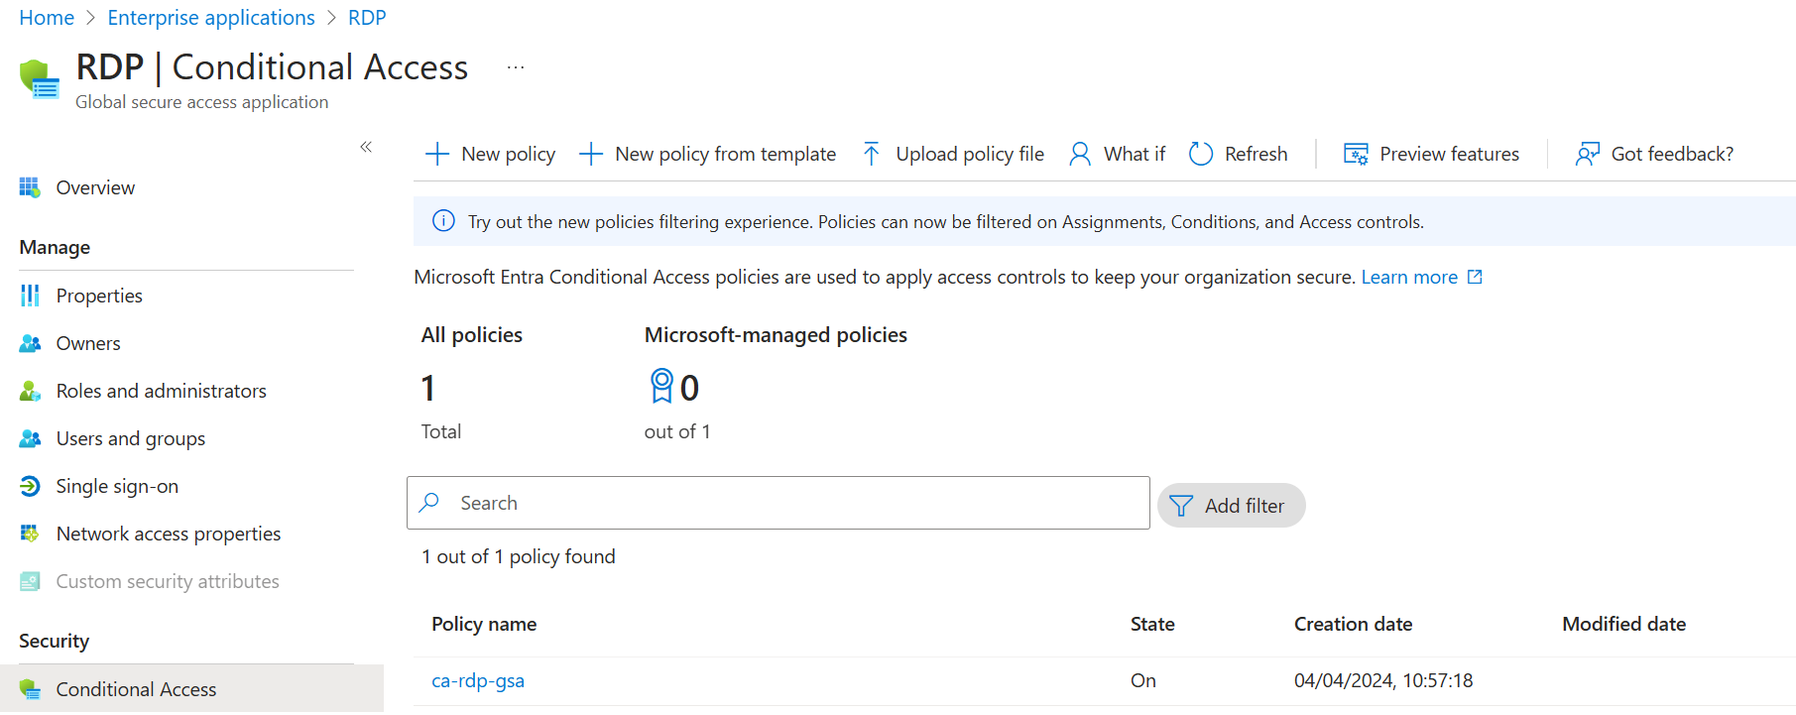
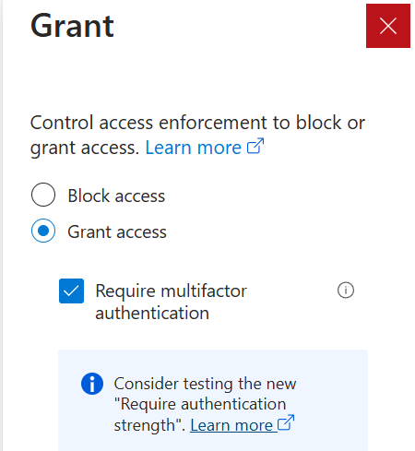
Example with Per App Access

Slide 17
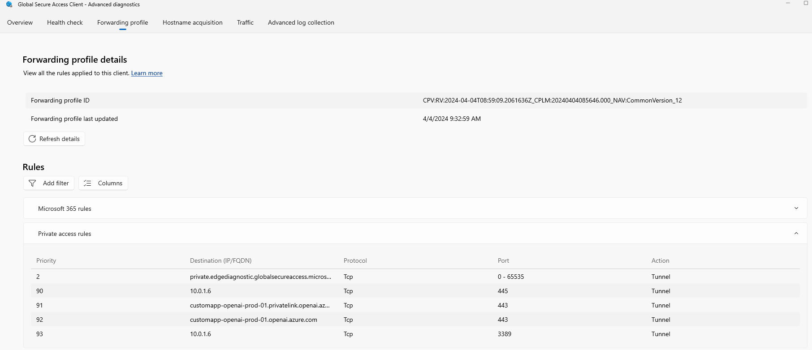
Example with Per App Access

Slide 18
Example with Private Endpoints
Can have different CA policies per app or service
Can have different connectors per service / location

Slide 19
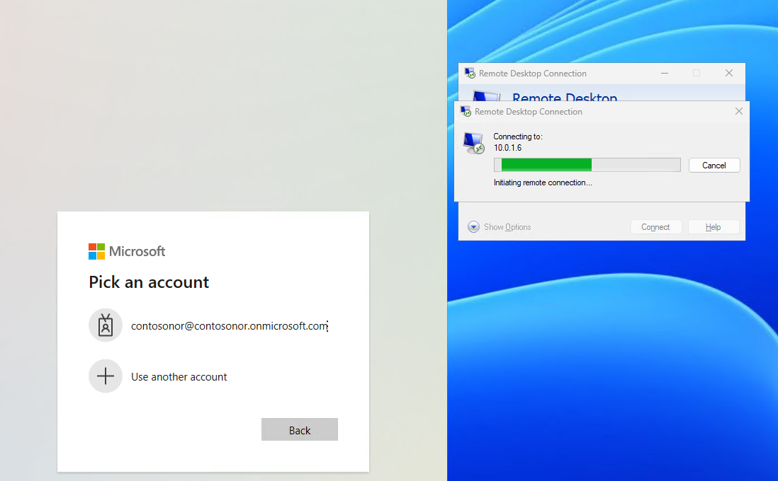
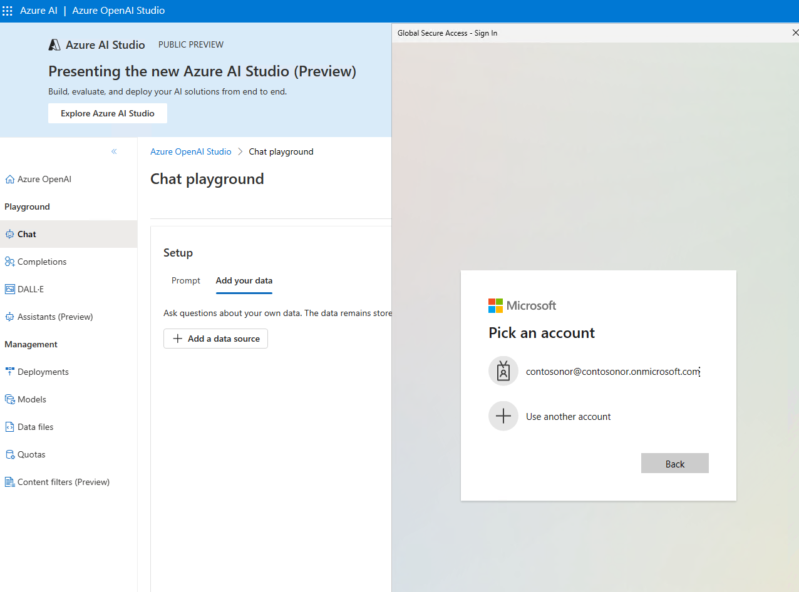
Example with Per App Access
Services with Private Endpoints
RDP with MFA

Slide 20
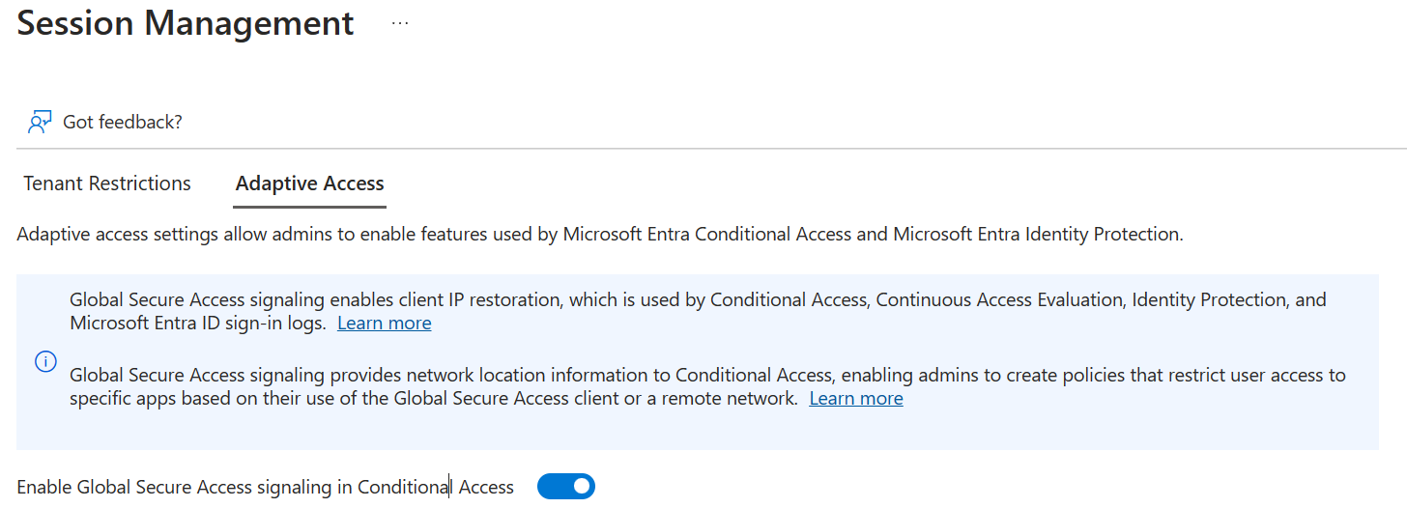
Other features that you should be aware of
Tenant Restriction
Restrict users from other Entra ID directories to access services using our devices
Adaptive Access
Provides Network Signals to Conditional Access
If this is not enabled source IP will be the Global Secure Access and not the actual public IP the client uses
This causes Impossible Travel alerts - big time!

Slide 21
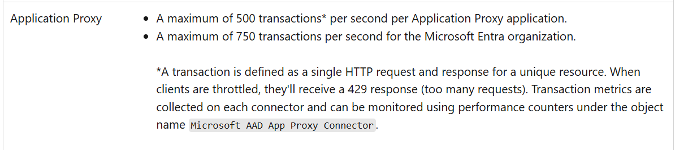
Some limitations that you should be aware of
Does not fully support IPv6
WILL ADD ADDITIONAL LATENCY
Does not support DoH (DNS-Over-HTTPS)
Does not support UDP for internal services (yet...)
For instance QUIC protocol needs to be blocked
Can support Entra ID B2B If device is home to the main Entra ID Tenant
Single label domains are not supported
For instance https://service01
Tunneling traffic by IP Address requires that the IP Ranges are outside of the end-user device local subnet
Remember that Apple devices do not support routing traffic with services that end with .local
Apple devices might not open your internal network’s ‘.local’ domain - Apple Support

Slide 22

ZTNA now with Global Secure Access
Entra Directory
Azure Virtual Desktop / W365
VDI
GSA ( Public Access)
SaaS
Global Secure Access – Private Access
Intern Web
Conditional Access
TCP/UDP
Intune & Defender
SSH/K8s
TCP/UDP

Slide 23
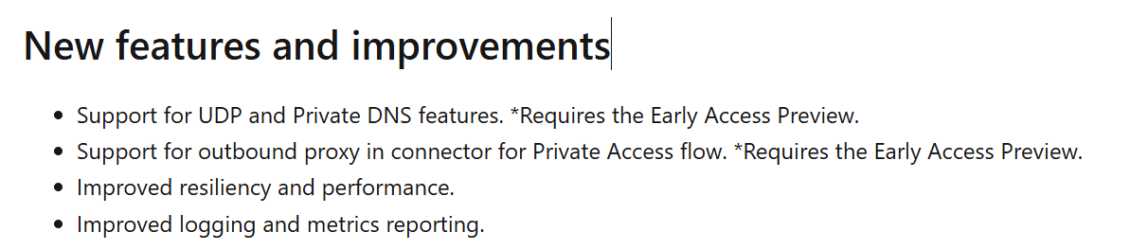
Some final things
Not all features in App Proxy which available in Secure Access yet – Configured seperatly
Still.. There are other alternatives that use better and faster protocols such as MASQUE

